Slide 1
Facial Recognition Application
Ari Burch, An Huynh, Sofia Lee

Slide 2
What We’ll Go Over
1. Project Overview
2. Relevant Background and Problem Specification
3. Algorithms, Tools, Libraries
4. Design
5. Challenges
6. Demo
Notes:
Ari

Slide 3
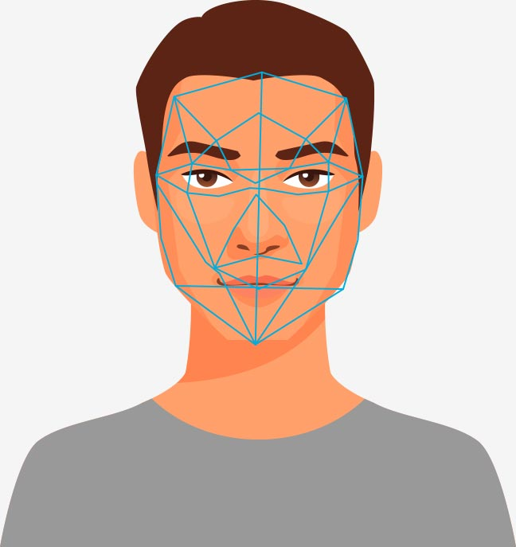
Project Overview
Problem we’re trying to solve: Making a system that can (accurately) identify a person (via facial recognition)
Work on project with topics none of us have worked with before - Computer Vision and IoT
Networking components to manage different aspects of system
Use Cases: Security, social applications, accessibility, etc.
Notes:
An

Slide 4
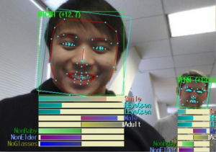
Computer Vision Background
Convolutional Neural Networks
Widely used after 2012 ImageNet Competition [1]
ResNet, VGGNet, AlexNet, GoogLeNet, etc. [2]
Facial/Object Recognition
FaceNet [3,4]
FaceNet is introduced in 2015 by Google researchers
Suitable for face recognition, verification and clustering
Pre-processing algorithms
[1]http://image-net.org/challenges/LSVRC/
[2]https://medium.com/@sidereal/cnns-architectures-lenet-alexnet-vgg-googlenet-resnet-and-more-666091488df5
[3] https://arxiv.org/pdf/1503.03832.pdf
[4] https://medium.com/intro-to-artificial-intelligence/one-shot-learning-explained-using-facenet-dff5ad52bd38
Notes:
Ari

Slide 5

Algorithms
Convolutional Neural Networks (CNNs) are designed for classifying image inputs with machine learning
Implemented in Python packages like Tensorflow, PyTorch, etc.
Numerous tutorials and papers written [1,2]
CNNs implicitly use image processing techniques to extract features from an image, then classify
Preprocessing algorithms to manage:
Brighten images and reduce blur
Segmentation of face from full image
[1]https://www.datacamp.com/community/tutorials/cnn-tensorflow-python
[2]https://realpython.com/face-detection-in-python-using-a-webcam/
Notes:
Sofia

Slide 6

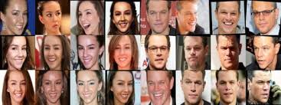
Image/Video Dataset
Access to live video streaming (external webcam)
Existing tutorials and literature available
Python OpenCV, etc.
Use model pre-trained on FaceNet dataset
FaceNet is the standard for facial recognition tasks
Transfer learning with custom dataset - celebrities and our faces
End goal was to make it as unbiased as possible
Notes:
Ari

Slide 7
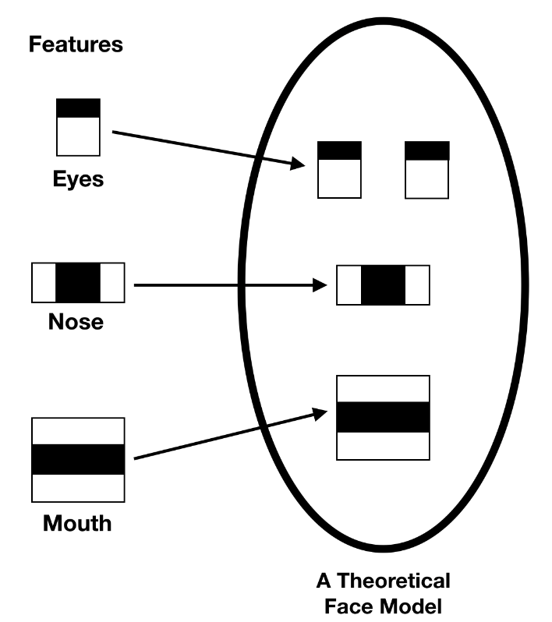
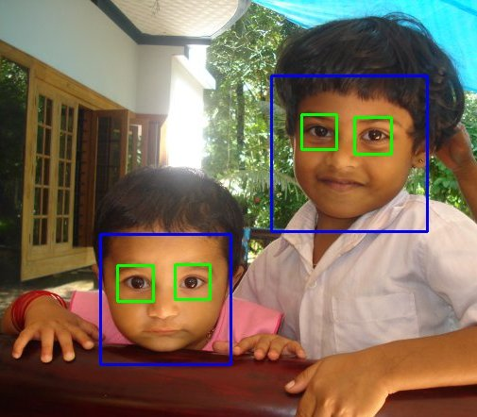
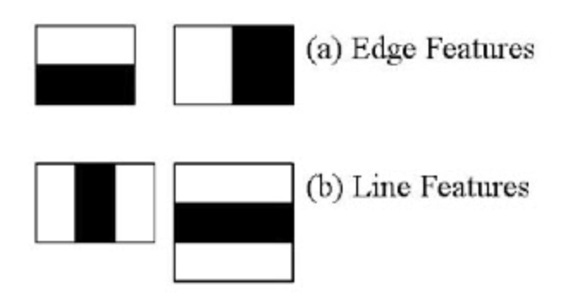
To Recognize and Detect Face
FaceNet
Already trained to solve face recognition and clustering problem with efficiently at scale
OpenCV + Haar feature based classifier
Analyzes the pixels in the images in squares
Uses dark and bright pixels to detect specific features/edges of the face
Helps to extract face for FaceNet to recognize
Notes:
Sofia

Slide 8
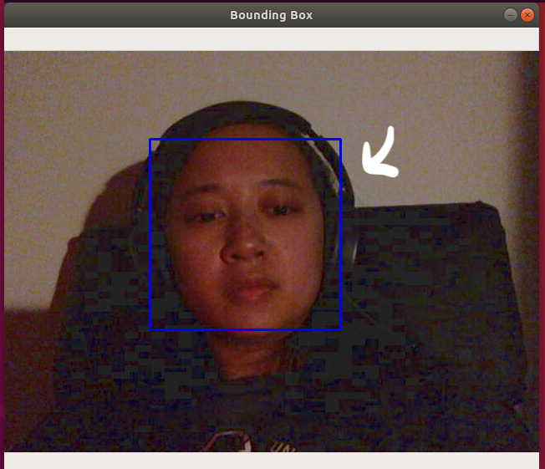
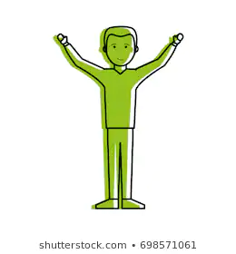
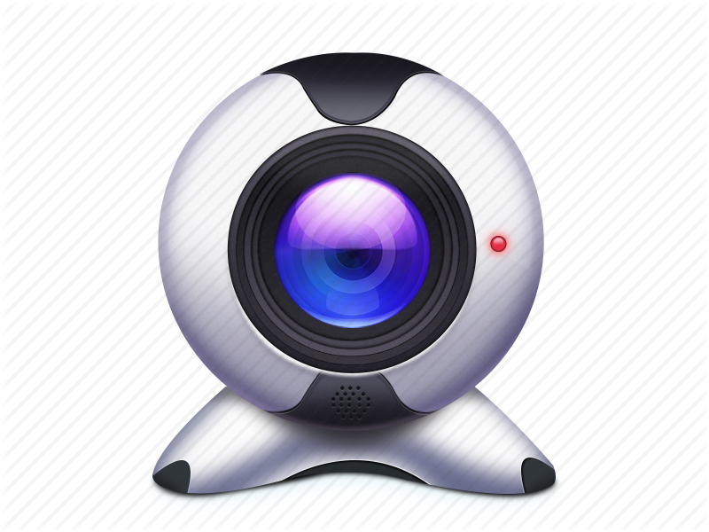
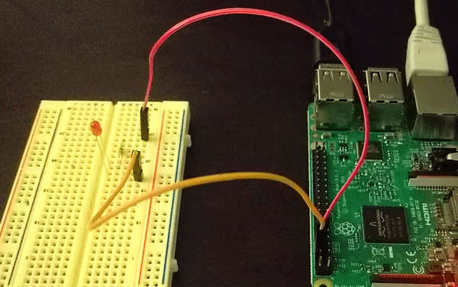
Computer Vision Design
Testing
Preprocessing Algorithms
Input
User Alert
Webcam
{“redLight, “On”}
Trained Model
Notes:
An
“So how the project works is that you turn on the webcam and you have a person face the camera. You know a person is facing the camera correctly if you see a blue bounding box around the person’s face when they look into the camera. The camera implements preprocessing algorithms to both align and brighten the image that way the program and identify the person’s face easier. Then, Facenet uses our trained models to identify the person’s face and output the person’s image that is saved within our dataset. If the person’s face is not identified, the program publishes a mqtt message to the rasp pi to blink the red led light, and vice versa, the rasp pi will blink the green led light”

Slide 9
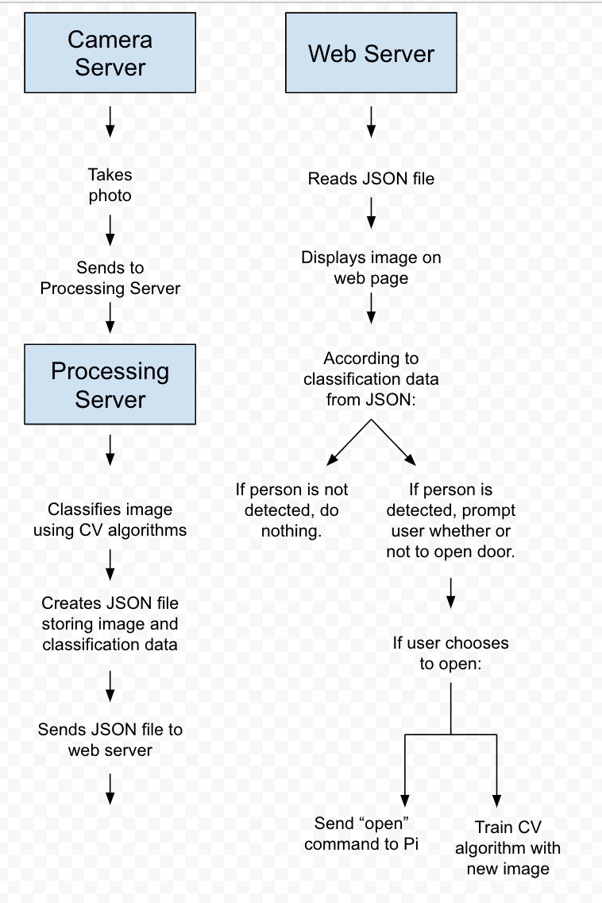
How we set up web page demo
The camera server and web server maintain a TCP connection using websockets.
Through this connection, the camera server receives a command to take a photo and upload it via FTP to the web server.
Once received, the image is analyzed and displayed on the web page.
Notes:
Ari

Slide 10
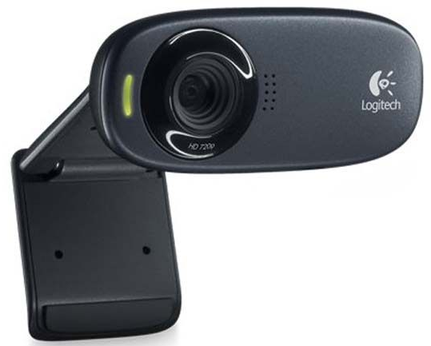
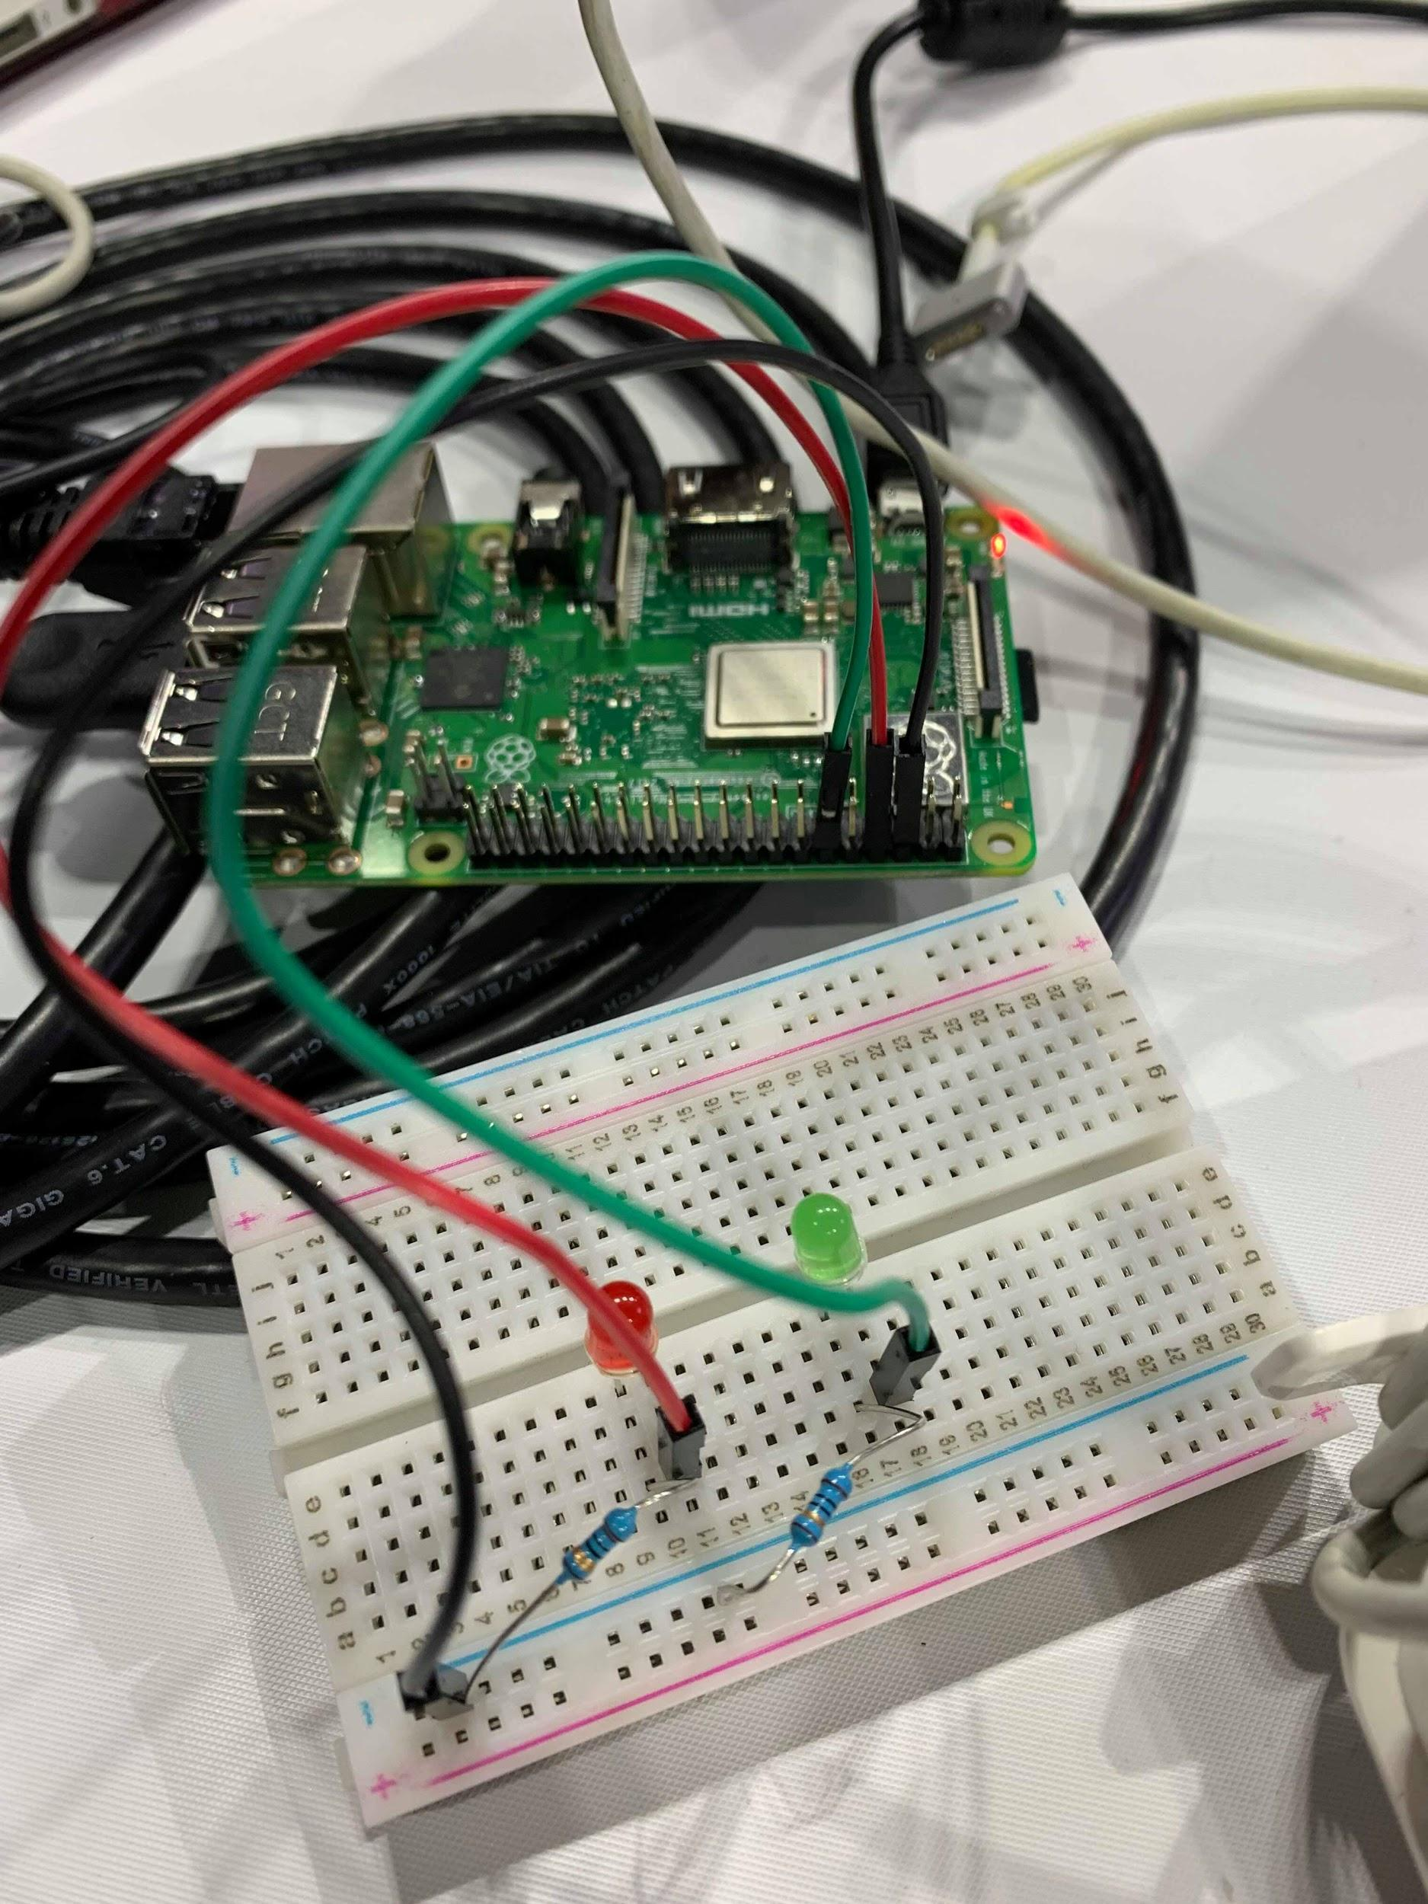
Methods and Tools
Raspberry Pi with LED flashing lights for user alerts
Webcam
Camera Server
Preprocessing and Classification Server
Web Server
Python
Anaconda Distribution
To manage python library versions
OpenCV
To get access to camera and draw bounding box where face is identified
Tensorflow
To identify input with face from our dataset
Notes:
An
“In terms of hardware components, we are using the user’s webcam and a raspberry pi connected to a breadboard with 2 led lights. Software wise we’re using Python which involves using OpenCV and a facenet library called facenet_recognition”

Slide 11
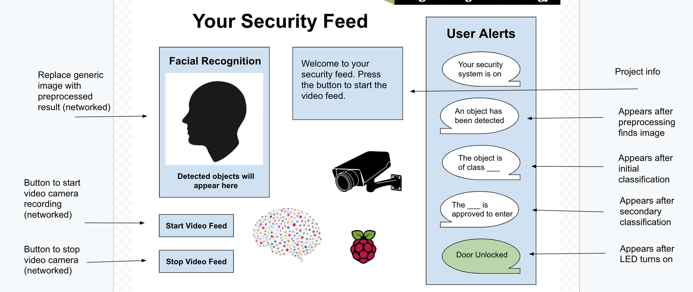
Web Page Design
Notes:
Ari

Slide 12
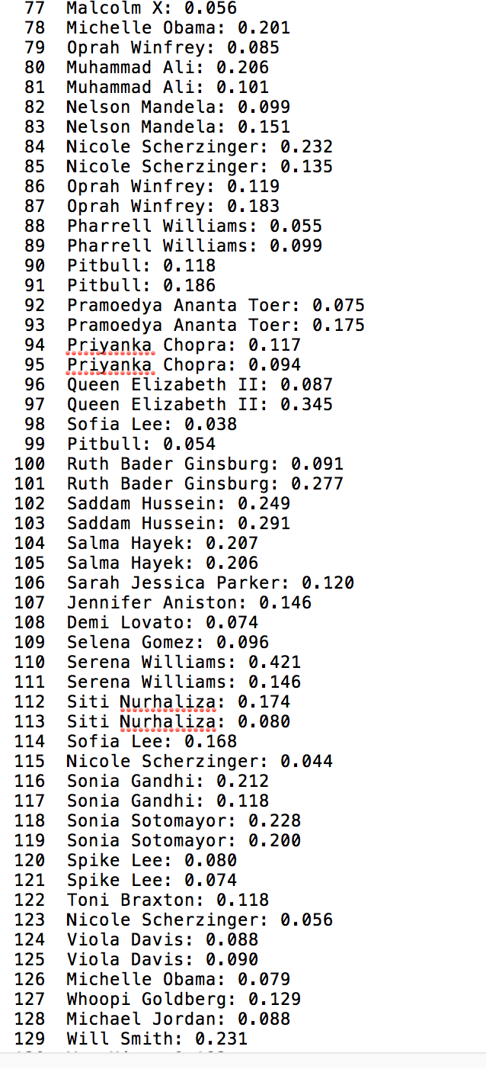
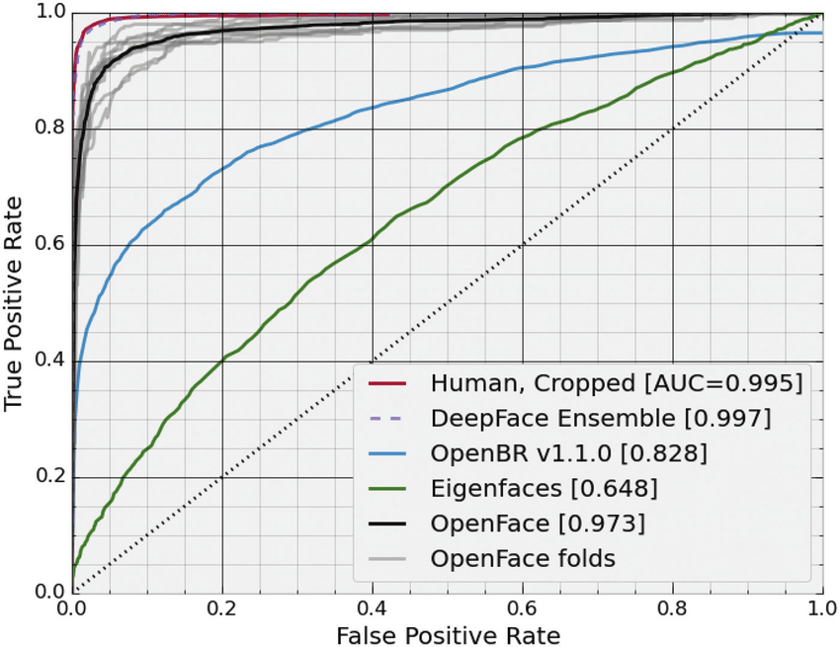
Results
85%+ testing accuracy, 95% training accuracy
Higher accuracy on faces with more training examples (ex. our faces, Serena Williams, etc)
Notes:
Ari

Slide 13

Challenges/Methods Questionnaire
Issues with working on project cross-platform (Mac vs. Windows vs. Raspbian)
Setting up Node Red on pi and getting it to control LEDs
Trying to dynamically update web page
Getting program to identify faces well (Kept mixing up Asian people, I mean not surprising but still.)
Notes:
An
“Some of the challenges we encountered was figuring out how to get the code to work across different platforms since each platform had different requirements software wise. We also had trouble at first with getting the app to recognize faces well as it kept mixing up several asian people in our dataset”

Slide 14
Demo (Website)
Notes:
Ari

Slide 15
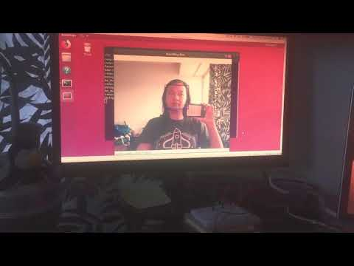
Demo of LEDs Blinking
Ended up recording demo because raspberry pi cannot connect to eduroam
Side Note: MQTT is a machine-to-machine “Internet of Things" protocol. It’s a lightweight messaging transport, which gets the job done for this particular project.
Notes:
An

